Slide 1
PiRail
Investigation

Slide 2
ReactApp - Broad Structure

Slide 3
App
Contained by Index module
Wrapped with modules providing data
Contains all other modules
Home
IMU
Lidar
Lpcm
Settings
Simulator
Router setup

Slide 4
Home
MapContainer
(Renders the tiled map)
Info Tab
Contains information for the map view
Add PoI Button
Opens modal to add a Point of Interest

Slide 5
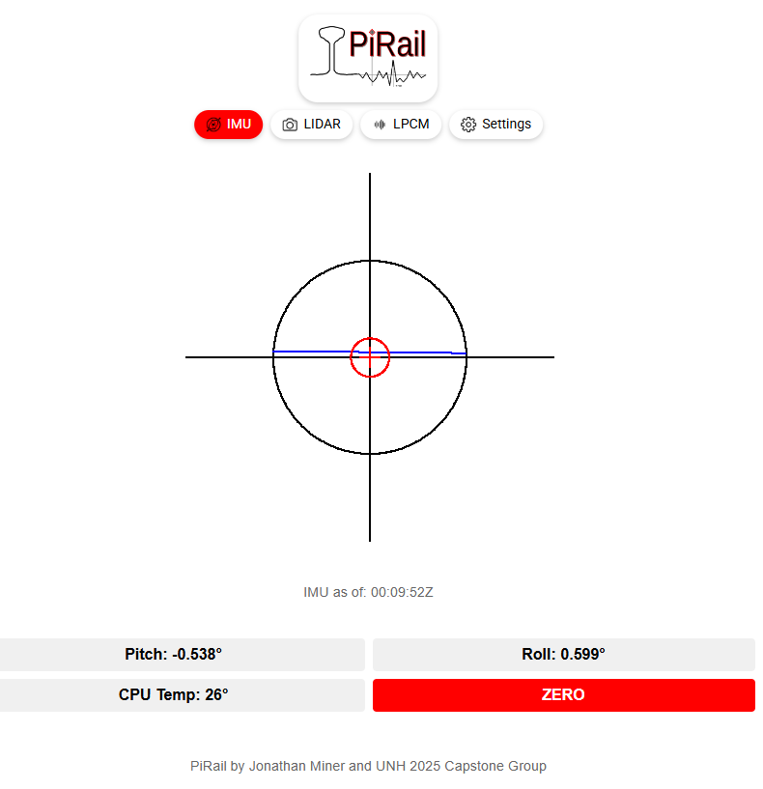
IMU
The IMU page displays the current information from the Inertial Measurement Unit within a gauge.

Slide 6
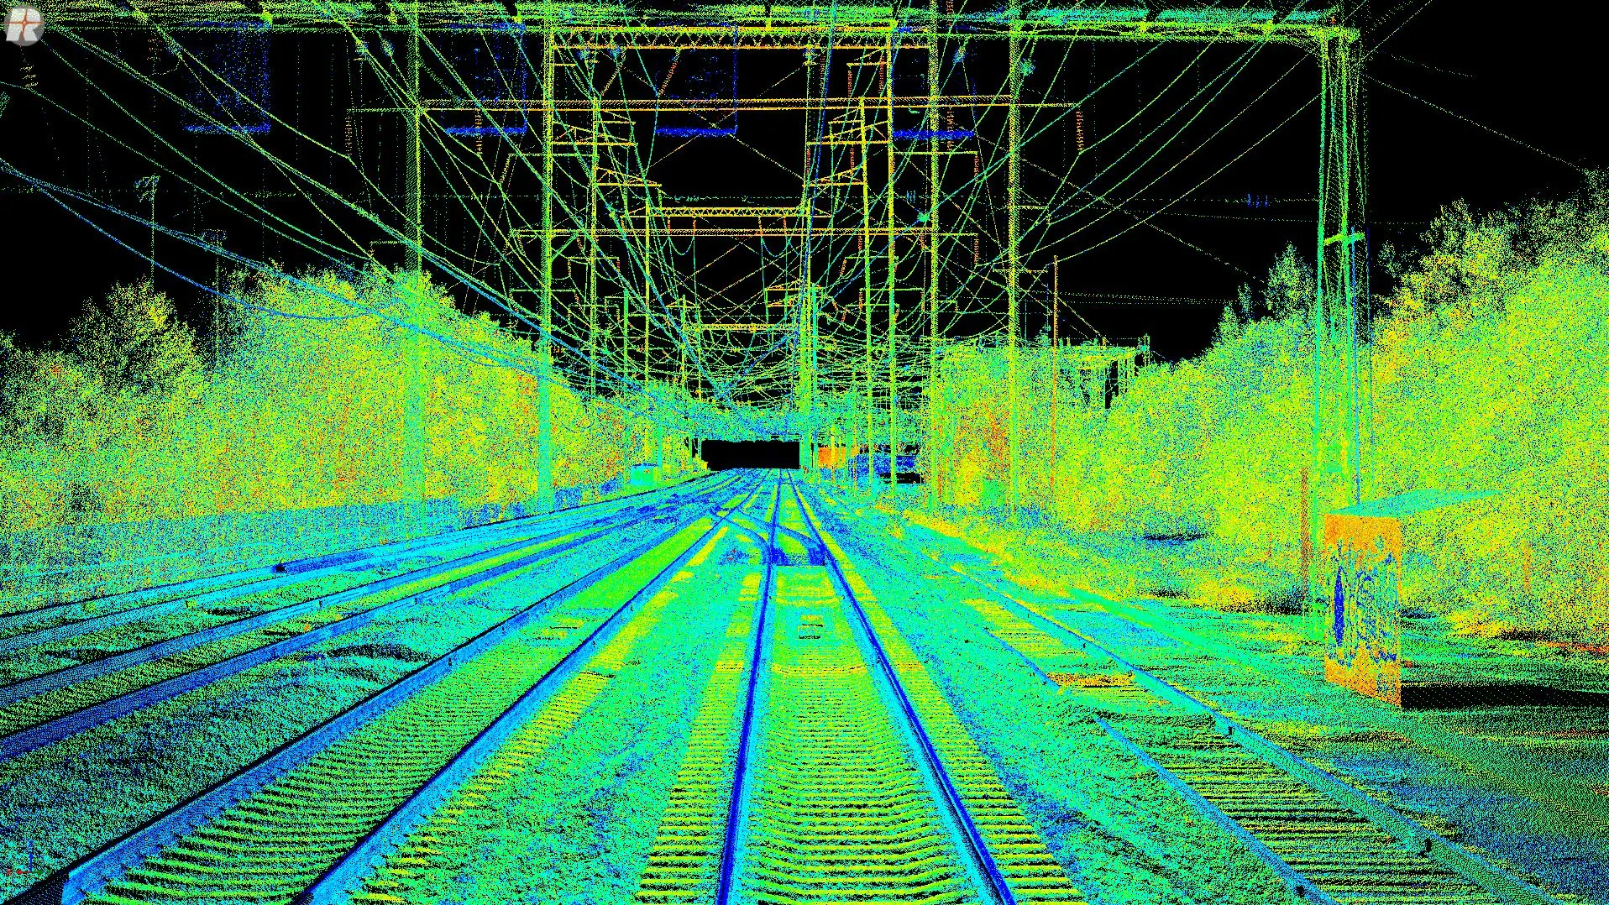
Lidar
Displays an image representation of distance data.

Slide 7
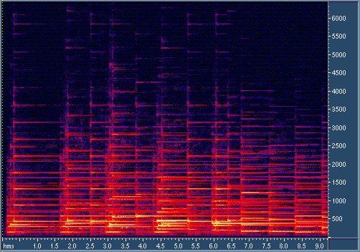
LPCM
Contains collected audio
Could be used to provide a spectrogram or other useful representation
Spectrogram Example:

Slide 8
Simulator
Used to load historical data for observation
Can generate random data for testing
Loaded and generated data is viewed throughout the application

Slide 9
ReactApp - Potential Work

Slide 10
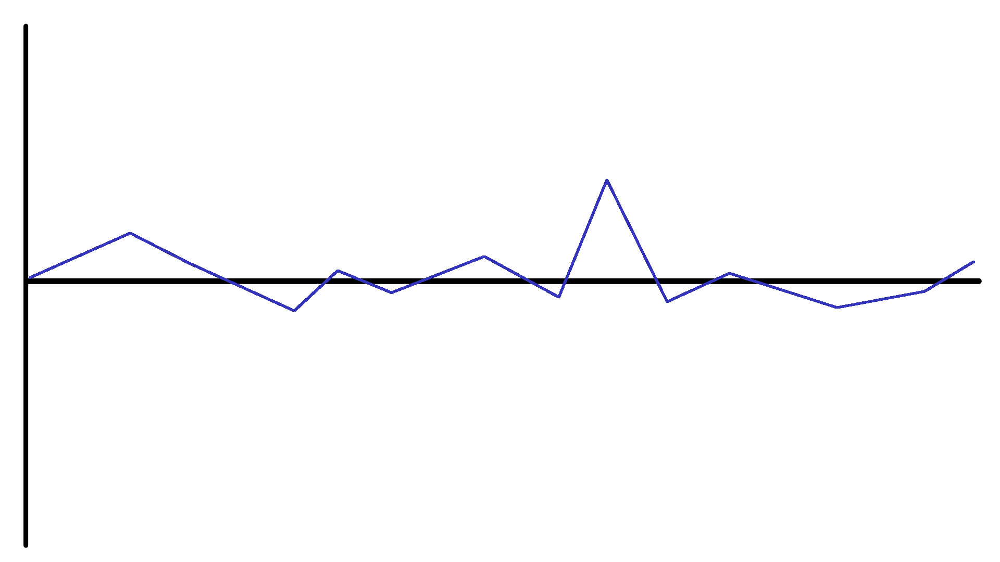
Representing IMU Data Over Time
Currently IMU data is a snapshot of
Roll
Pitch
Yaw
On a gauge:
Suggested:
Notes:
Currently IMU data is represented as a snapshot of its current state (roll, pitch, and yaw) via a gauge, but it would be more useful to represent the data in a different way so changes can be shown over time in a 2d graph.
An option I am presenting is:
Pitch as height, Yaw as point size, roll as a gradient between two accessible colors such as blue and yellow, and time as the horizontal axis.

Slide 11
Machine Learning Module

Slide 12
Overview
The current code is a very limited test, probably just a proof of concept.
All of the currently implemented models are supervised, but we (probably) do not have sufficient training data.
Previous models are from the scikit learn module. They have good reliable implementations, so we should probably continue using them at least for proofs of concept.

Slide 13
Previously Implemented Models
K-Nearest Neighbors: Predicting label based upon the k training entries that are most similar to the entry being predicted.
Support Vector Machine: Attempts to establish a boundary between entries with different labels. Prediction is based on which of the established zones an entry falls into.
Logistic Regression: Fits a function to the explanatory variables that estimates the probability of being True/False given the input.
Multilayer Perceptron: Neural network.
Decision Tree Classifier: A series of branching nodes that sort entries into leaf nodes based on whether they meet criteria of each node that leads to the leaf.

Slide 14
The Issue with Supervised Learning
Supervised learning requires training data with correct labels so that the model can learn from it. Our project sponsor gave the impression that this data was not easily accessible to us.
The current ML module creates sample training data by assuming that an entry with a Z acceleration value that is more than 12 standard deviations from the mean indicates a damaged segment.
We already measure Z acceleration, so predicting it does not accomplish anything. Using it as a feature in our model seems more useful.

Slide 15
Unsupervised Learning
Attempts to identify patterns in unlabeled data.
Good for anomaly detection.
Models that might be worth testing:
K-Means clustering: Grouping data with data points that are similar. Implementation would be fast.
Time Series Decomposition: Estimates trend, seasonality and residual. Large residuals from the estimated pattern indicate anomalies. Seasonal component might be good for regular patterns (like joints between railroad segments).

Slide 16
GPS-PI Module

Slide 17
Overview
The purpose of the GPS-PI module was to take a modular Raspberry Pi based data logging system for accurate location and motion tracking
Core Features
Integrates GPS and IMU sensors
Processes GPS long, lat, speed, altitude and timestamps
Sends structured data (JSON) over UDP for real-time monitoring
Detects and initializes BerryIMU sensors (accelerometer, gyroscope, magnetometer)

Slide 18
How does this apply to PiRail
Project Goal: Assist railway maintenance teams by pinpointing POIs and logging repair locations along the track
Integration
GPS – Provides precise train or inspection position
IMU – Captures motion, orientation and vibration data
Data is timestamped, logged and transmitted for analysis

Slide 19
LIDAR Module

Slide 20
Overview
How LIDAR (Light Detection and Ranging) works
Lasers constantly emit light out in every direction
When the light hits an object, it bounces back after some time
It uses these things to calculate how far things are in the surrounding area
The result is a 3D model of the area that the lasers have been shooting at

Slide 21
How LIDAR Module Works in PiRail
Created 2 years ago
Created with the idea of detecting objects close to the track, seeing if they are "hard" or "soft" objects, and deciding if these objects would be a problem in the future
Currently not being worked on
Could be used in the future to decide on which areas should be indicated as POIs

Slide 22
Known Module

Slide 23
Known Module
What This Dataset Is
Each line = one geotagged feature along the rail corridor
Used to organize sensor findings and visualize potential issues
Record Format (Readable Schema)
lat, lon: WGS-84 coordinates (nullable)
milepost: Decimal mile along the line
code: Feature type (X, MP, O, S, CRF)
properties: JSON attributes such as name, crossing, start, end, or offset

Slide 24
Feature Codes
X – Grade crossings (often includes an FRA ID)
MP – Milepost markers (used to calibrate and align data)
O – Other assets or natural features (bridges, rivers, ponds)
S – Segment annotations (curves, offsets)
CRF – Corridor or region features with start and end mileposts

Slide 25
Use Cases
Data Integration: Export features to GeoJSON and load into GIS tools (QGIS, Mapbox, ArcGIS) for mapping and visualization.
Analysis & Validation: Align sensor readings with nearby features, verify mileposts and IDs, and ensure all key fields are complete.
Application: We use this data to identify and monitor key points of interest along the rail corridor.

Slide 26
Webserver Module

Slide 27
Webserver Module
Provides a user interface for interacting with the data on a website
Interacts with an external server where data can be hosted
Gives information about the project

